Slide 1
Building Empathy Remotely
23 JUNE 2021
Elyse Voegeli, NYC Mayor’s Office of the Chief Technology Officer
Notes:
Land acknowledgment: to recognize and respect the Indigenous Peoples whose traditional land we live on, and to acknowledge the enduring relationship that exists between Indigenous Peoples and their traditional territories.
Munsee lenape
Canarsie
If you want to learn about the land you live on: [share in chat] https://native-land.ca/

Slide 2
Roadmap
1
Hi!
2
Background
3
Learnings
NYC.GOV/CTO
Notes:
Some of what I’ve learned in this past year on empathy in remote design research through the lens of a case study from my team.

Slide 3
Section 1
01
Hi!
NYC.GOV/CTO
Notes:
[skip]

Slide 4
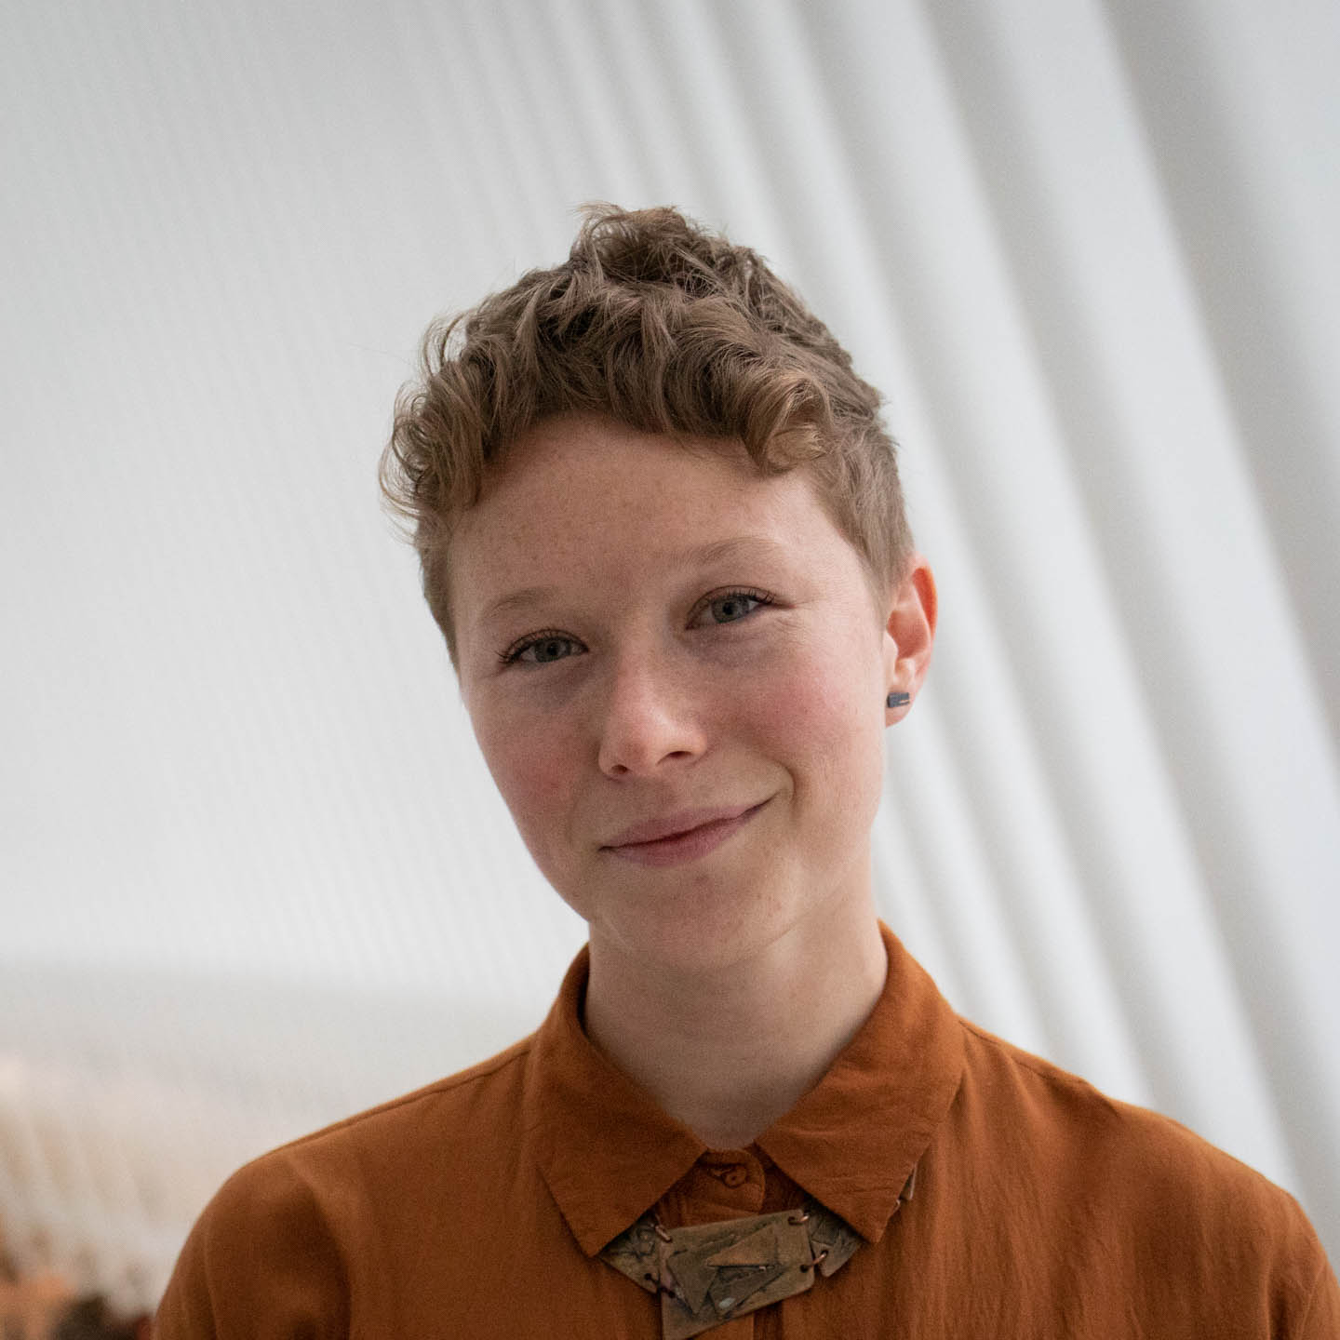

About Elyse
Elyse Voegeli (she, her)
User Experience Designer & Researcher
New York City Mayor’s Office of the CTO
@NYC_CTO @evogues
Notes:
“I care about making sure the products and services we design are user friendly, accessible, and meet the needs of New Yorkers.”

Slide 5












About the Office
Our work and our team spans traditional disciplines
Universal Broadband
Digital Services
Inclusive Innovation
Emerging Tech & Society
Bringing high-quality, affordable, and safe internet service to all New Yorkers.
Building digital services that make government work better for everyone.
Making NYC the place to introduce new ideas that improve lives.
Advancing policies that bring about good technologies and technology use.
Notes:
4 pillars
This project crosses all of them

Slide 6
Section 2
02
Background
NYC.GOV/CTO

Slide 7
Broadband Access in NYC
Broadband Access in NYC
40%
46%
NYERS LACK MOBILE OR HOME BROADBAND
NYERS LIVING IN POVERTY LACK HOME BROADBAND
18%
1.5m
NYERS LACK BOTH MOBILE AND HOME BROADBAND
NYERS LACK BOTH MOBILE AND HOME BROADBAND
NYC.GOV/CTO
Notes:
18% NYers lack mobile and home broadband
Our office has been working for a while
Internet is a human right
Exacerbated by pandemic

Slide 8
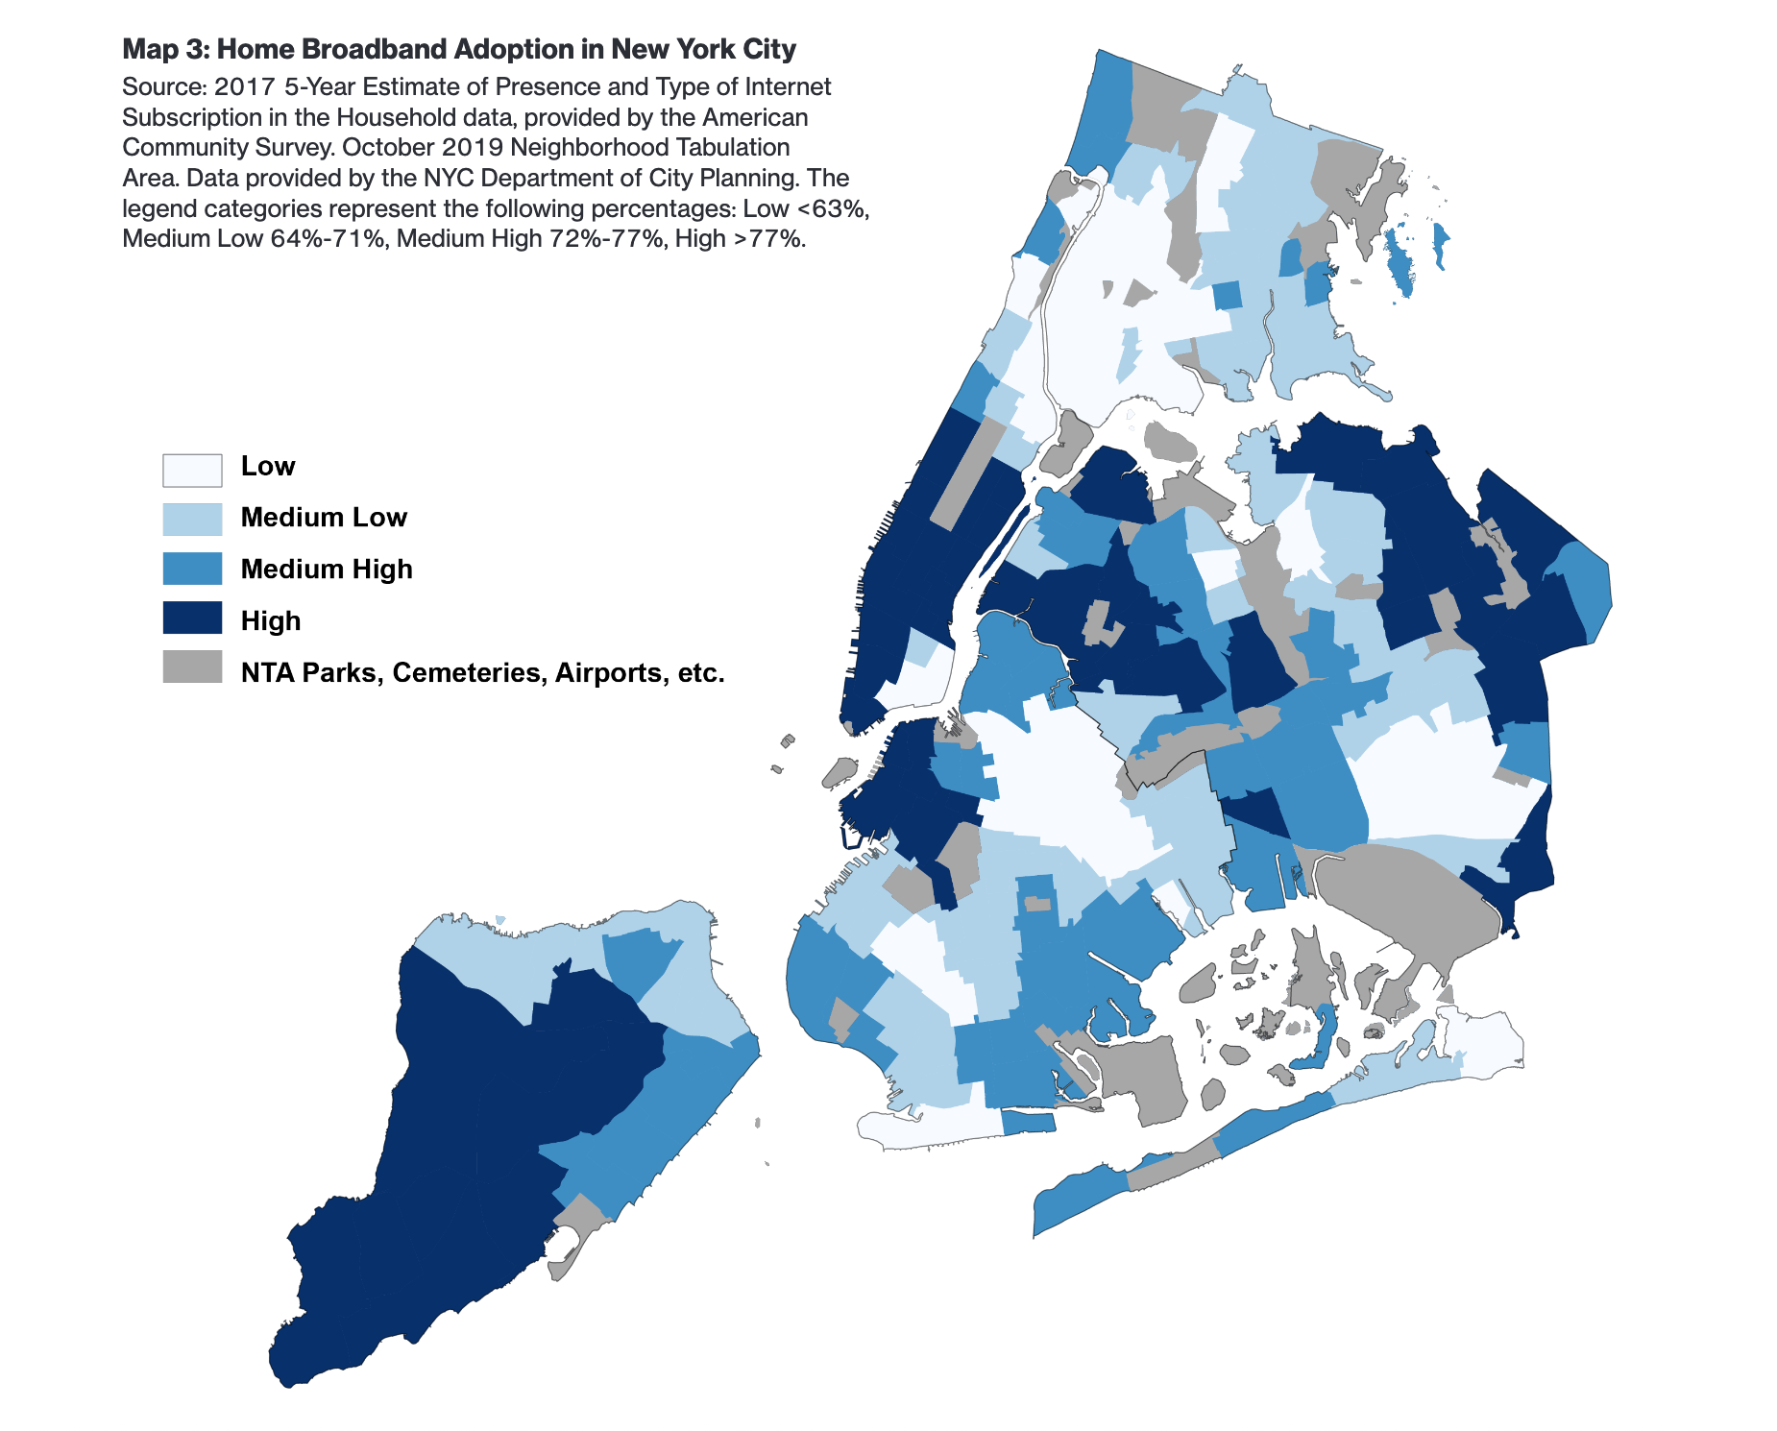
Home Broadband Adoption
Home broadband adoption
Source: The New York City Internet Master Plan,
Data from the 2019 American Community Survey
NYC.GOV/CTO
Notes:
Unsurprisingly, maps to other in inequities (low income, Black and brown communities)

Slide 9
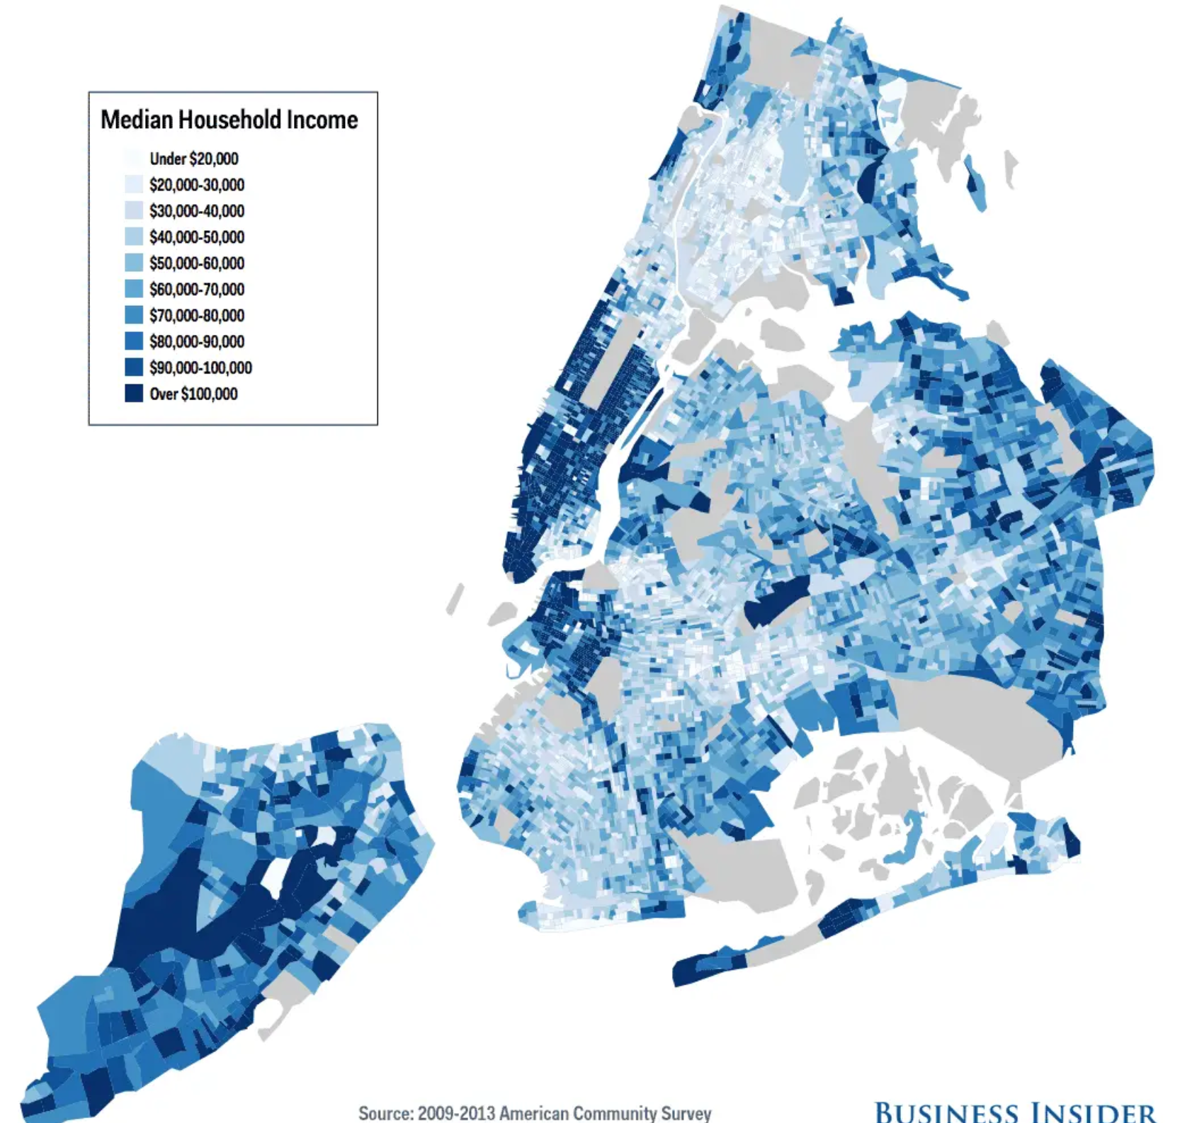
Median Household Income
Median household income
Source: Business Insider,
Data from the 2009-2013 American Community Survey
NYC.GOV/CTO
Notes:
Affordable internet as a justice issue
Pandemic = people realize that internet access is a need and a right

Slide 10
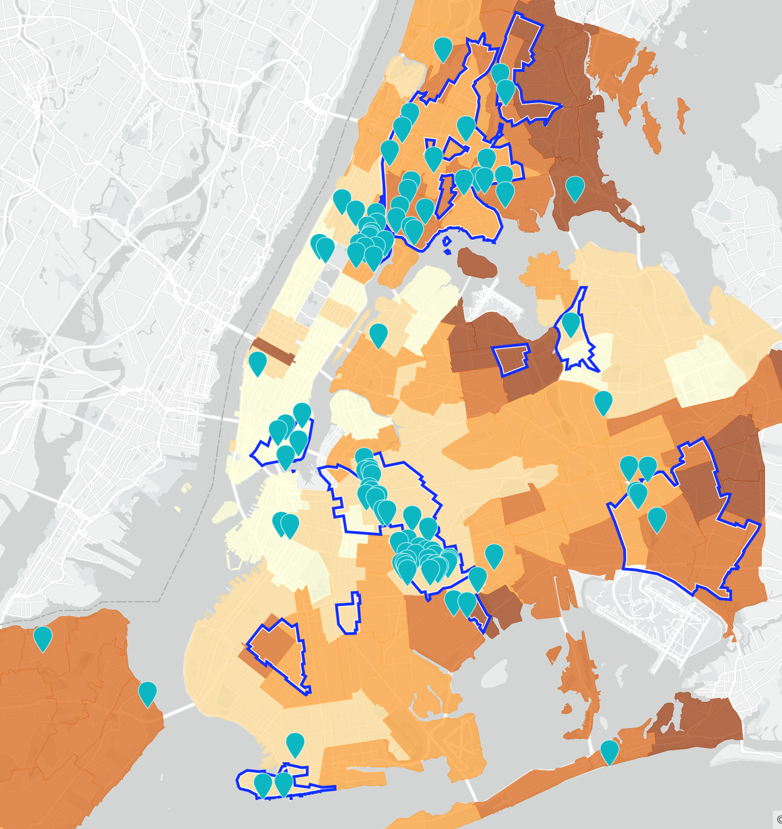
10K Tablet Program
10,000 internet-connected tablets for vulnerable low-income older adults
Notes:
-program background
-adults over 65 in NYCHA housing
-robocall to identify

Slide 11
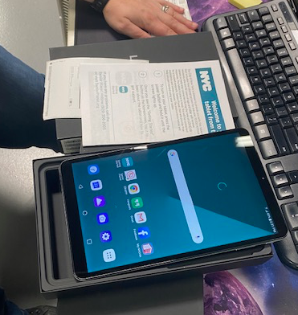
Service Design
Service design for the holistic
experience
Notes:
“Service design for the whole delivery, unboxing, and first use”
-kitting process
-default screen
-set up (SIM and set up already installed and ready)
-print out
Needs we designed for: language, accessibility, etc

Slide 12
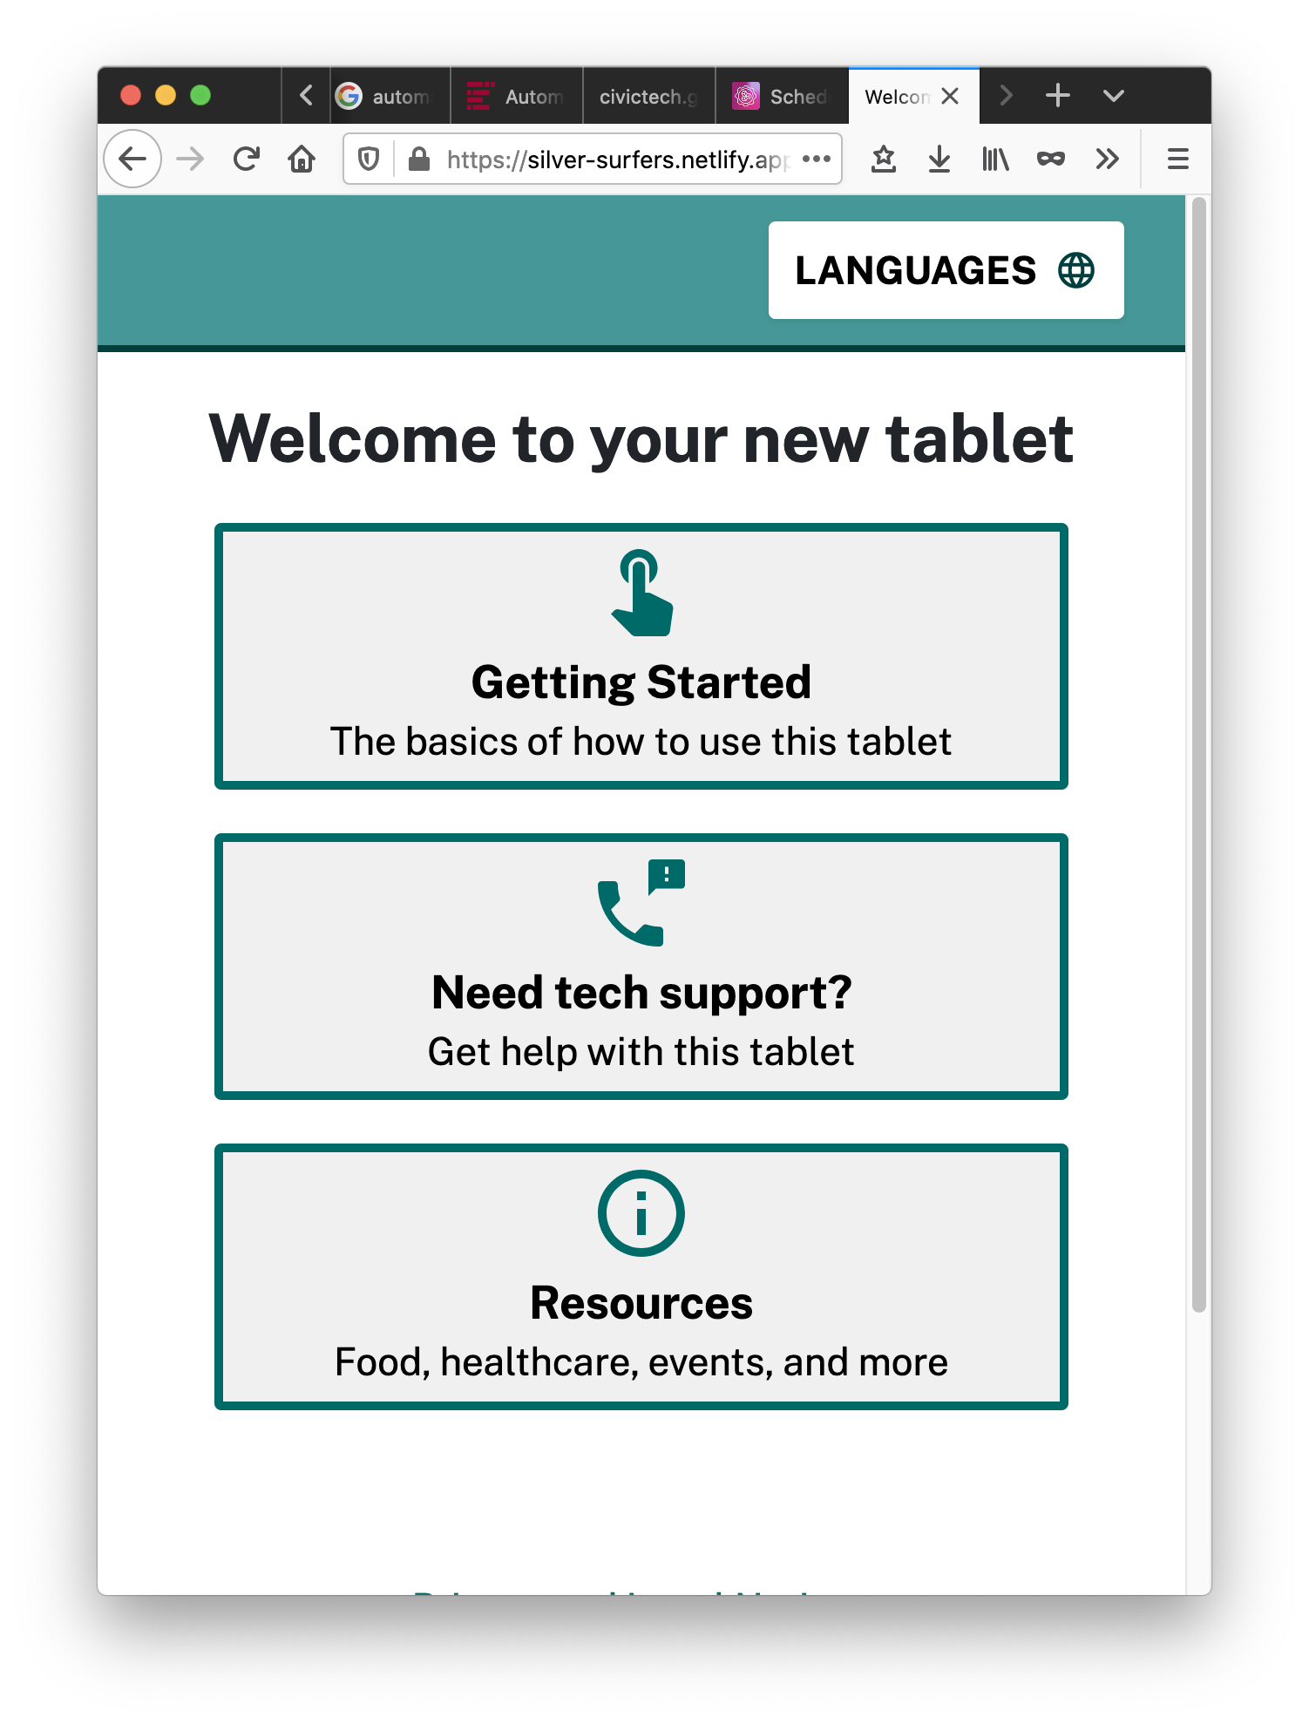
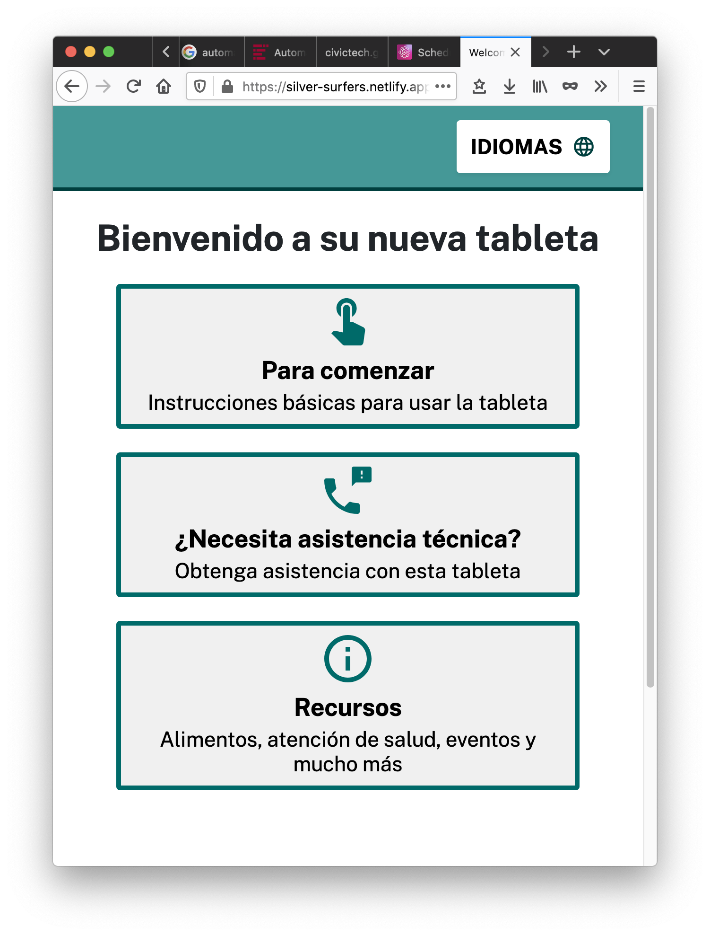
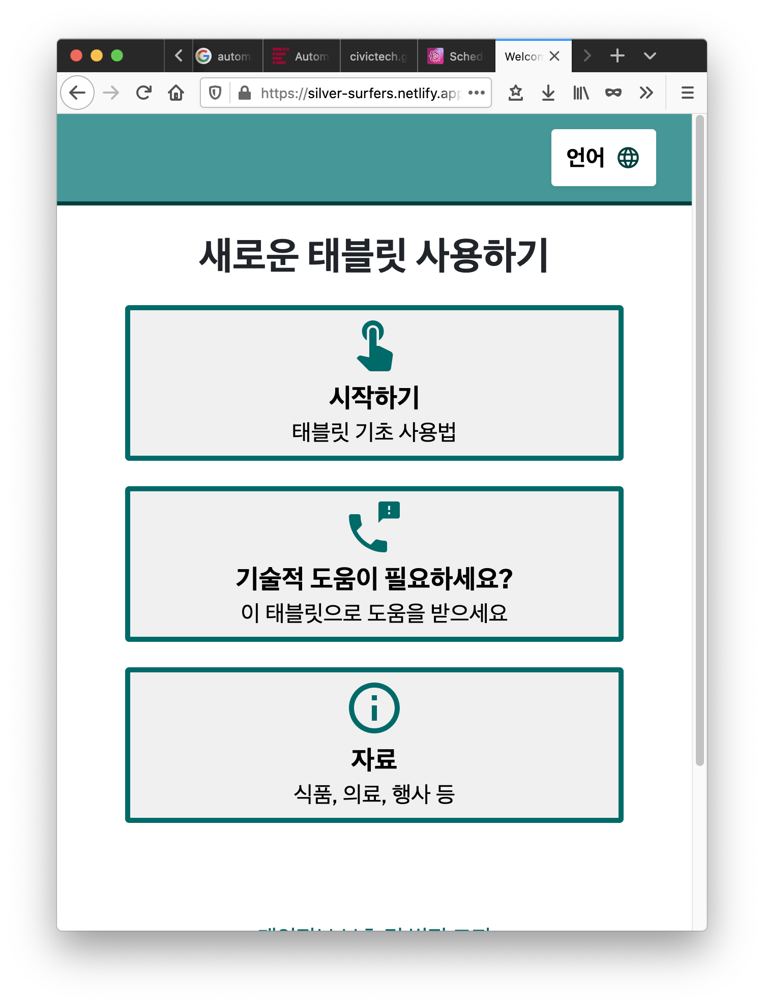
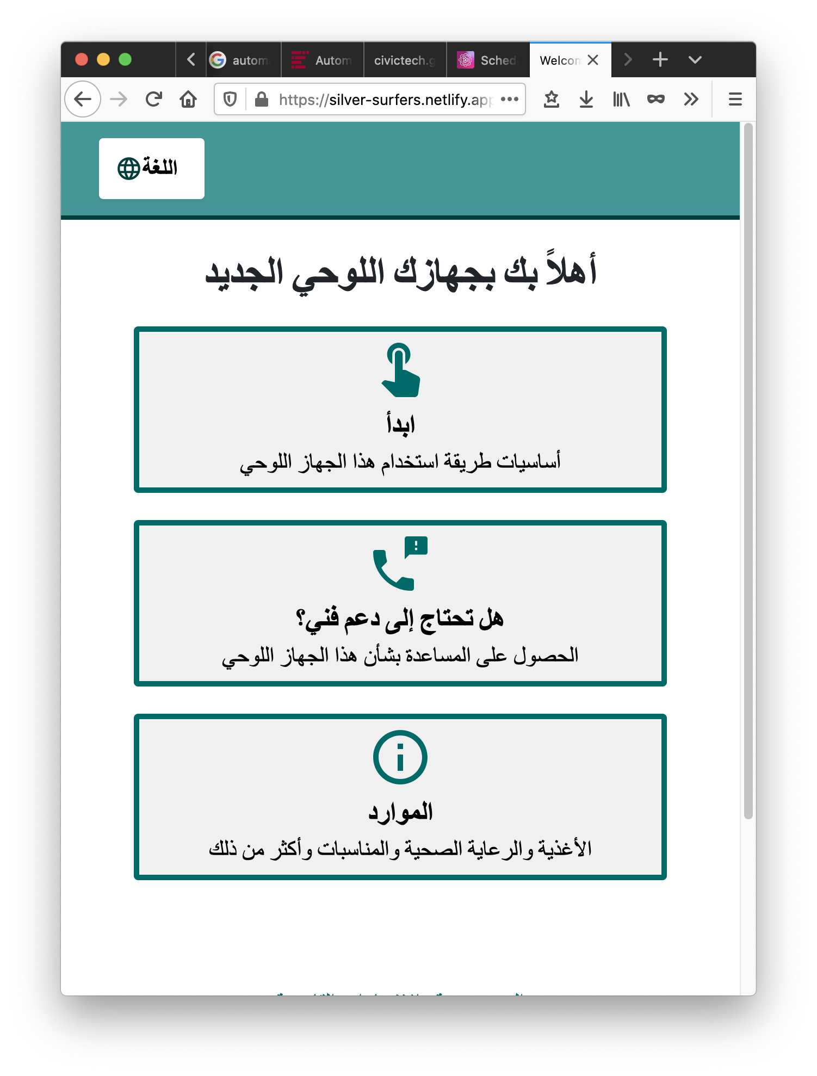
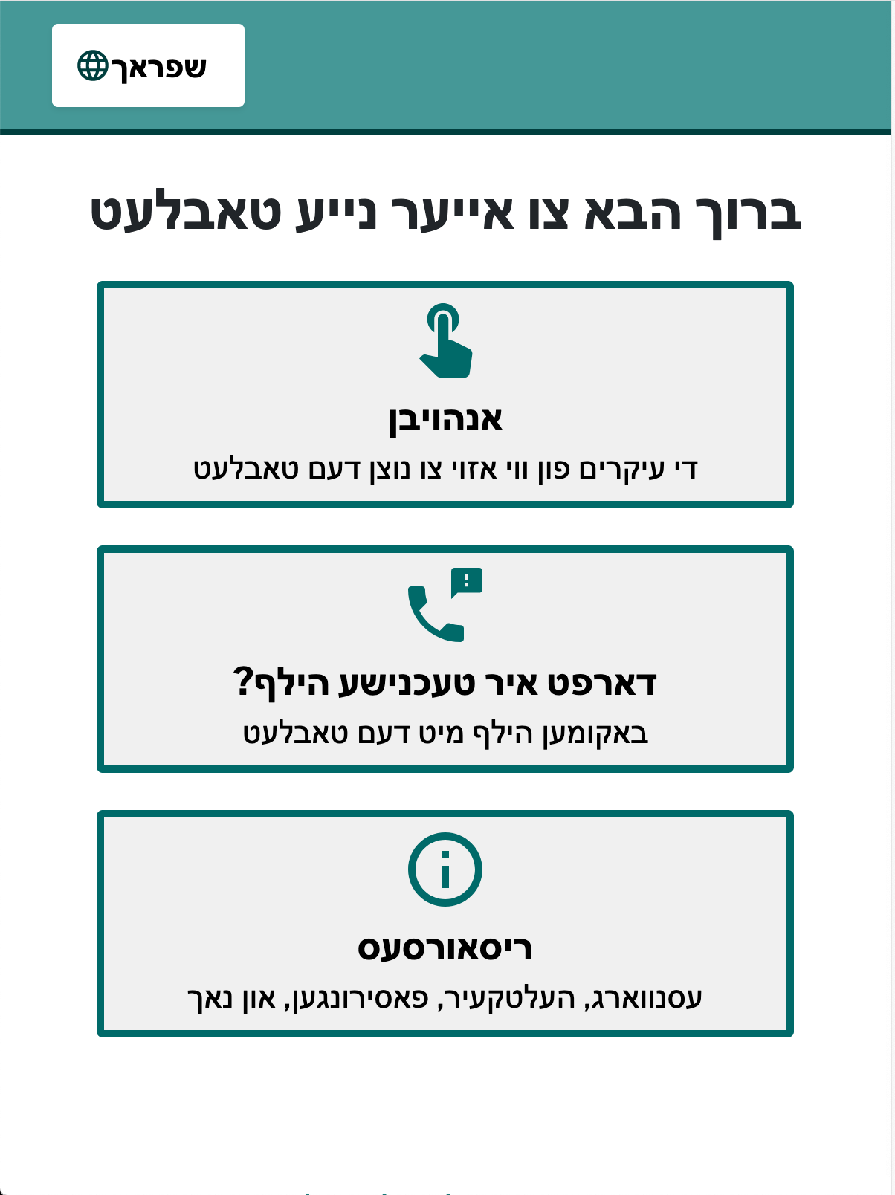
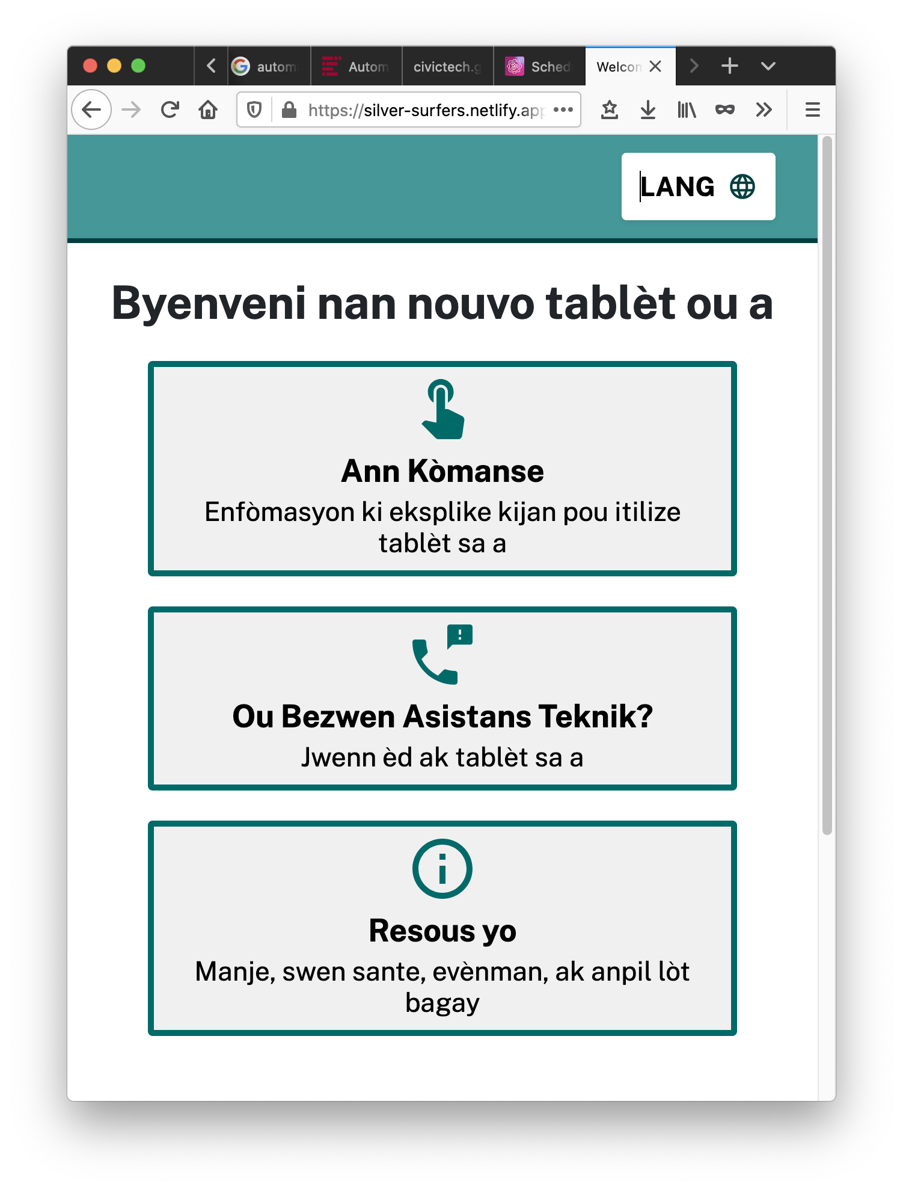
Design Considerations
Design considerations for accessibility, readability, language access
Notes:
Needs we designed for: language, accessibility, readability, etc
-high contrast, large text simple, readable

Slide 13
Section 3
03
Learnings
NYC.GOV/CTO
Notes:
Tips! - not the learnings from the research, learnings about the learnings.
You’re all experts in design

Slide 14
Empathy
EMPATHY
The ability to understand and share the feelings of another (Oxford languages).
NYC.GOV/CTO
Notes:
Level set
Empathy goes two ways
-empathy to make participant feel comfortable, consent
-empathy as a researcher. Don’t tokenize people.
Phone calls can feel inhuman sometimes. In person, its easy to remember “oh yes, that was Elyse, she had the weird hair and the cat shirt”. On the phone, you just have a voice.

Slide 15
Empathy 2
EMPATHY
The ability to understand and share the feelings of another (Oxford languages).
Empathy in design research is a two way street.
NYC.GOV/CTO
Notes:
Empathy goes two ways
-empathy to make participant feel comfortable
-empathy as a researcher. Don’t tokenize people.
Phone calls can feel inhuman sometimes. In person, its easy to remember “oh yes, that was Elyse, she had the weird hair and the cat shirt”. On the phone, you just have a voice.

Slide 16
Remote Research
Remote design research can feel like a black box
NYC.GOV/CTO
Notes:
Tablets to people who might not have devices or internet connection, so didn’t make assumptions and did research by phone. Some did not have email addresses. All of our research was by phone. Felt far away.
Phone calls can feel inhuman sometimes. In person, its easy to remember “oh yes, that was Elyse, she had the weird hair and the cat shirt”. On the phone, you just have a voice.

Slide 17
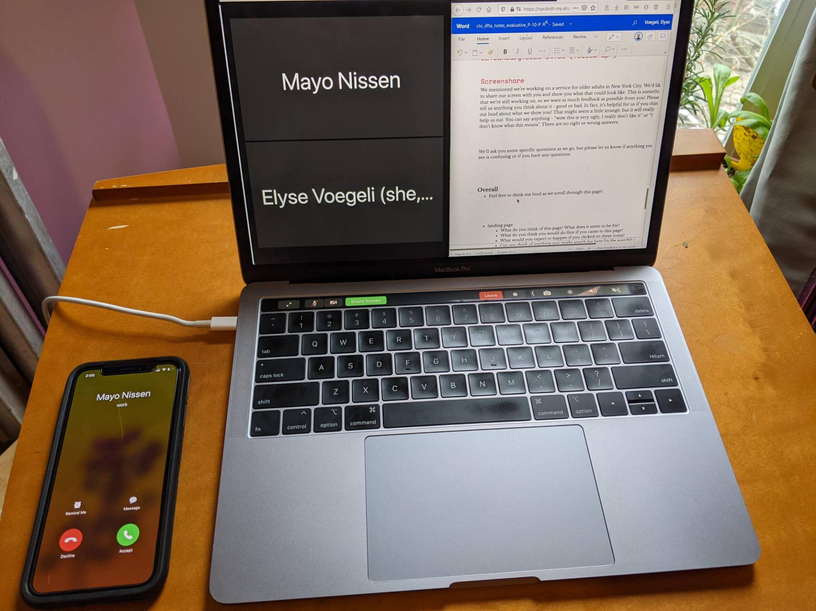
Learning 1
Embrace the awkward
NYC.GOV/CTO
Notes:
We worked with lawyers for something legally ok.
Better than a full disclaimer, but still legalese
Embrace + acknowledge the awkward

Slide 18
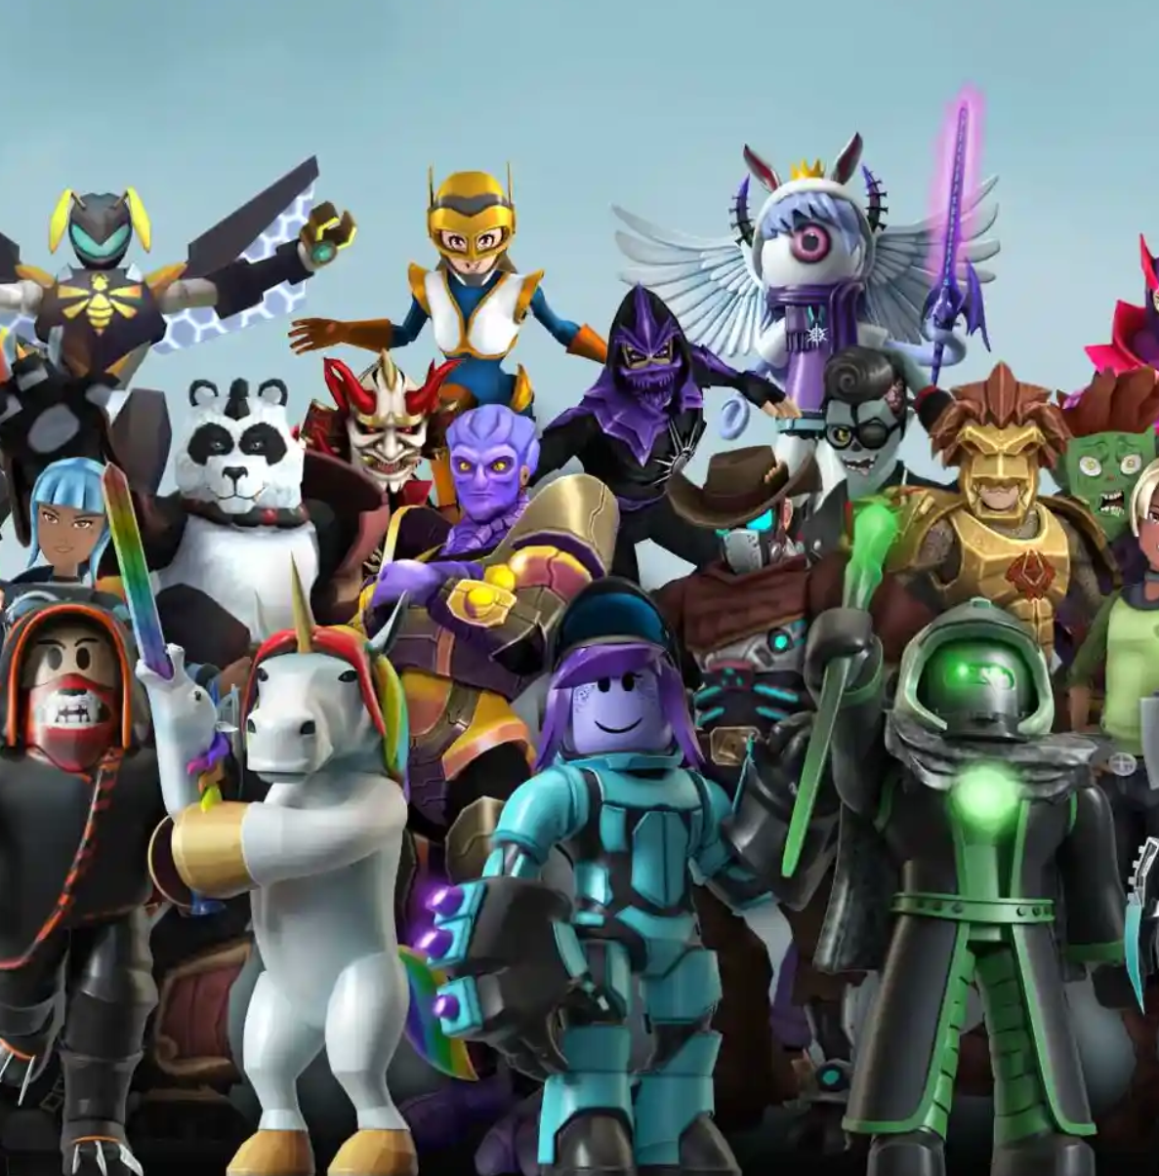
Learning 2
Photo: Roblox
Look things up
NYC.GOV/CTO
Notes:
Roblox - look it up while you’re talking, be honest

Slide 19
Learning 3
Use your senses unexpectedly
Photo: The Mighty Clouds of Joy from YouTube
NYC.GOV/CTO
Notes:
Listened to music while writing the notes.
Contextual information from home, office, etc.
Lacking things like body language, she described dancing in her bathrobe so we could imagine some of that body language

Slide 20
Thank you!
If you have any questions, feel free to reach out to me!
evoegeli@cto.nyc.gov, @evogues on Twitter, Elyse Voegeli on LinkedIn.

